Slide 1


Large-Scale Interactive Visualization with ParaView
Interactive Handling of Large Data Sets Minisymposium ICCE 2011
October 4-6, 2011
Kenneth Moreland
Sandia National Laboratories
SAND 2011-6794P
Sandia National Laboratories is a multi-program laboratory managed and operated by Sandia Corporation,
a wholly owned subsidiary of Lockheed Martin Corporation, for the U.S. Department of Energy’s National
Nuclear Security Administration under contract DE-AC04-94AL85000.

Slide 2
What is ParaView?
Notes:
Before we begin, let’s explore what the ParaView application is.
Why interactivity is so important.

Slide 3
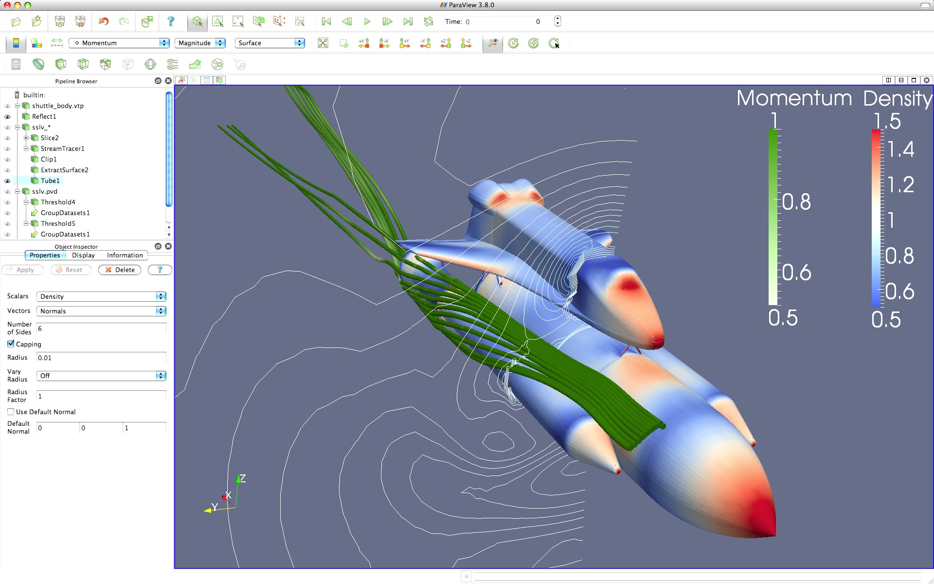
ParaView is a Visual Analysis Tool
Notes:
ParaView: a Visual Analysis Tool for Scientific Data (primarily simulation results)
In this simple example, we’ve loaded the simulation results of the airflow around a shuttle body
We see the shuttle itself with its surface annotated with the air density.
We have streamlines showing the airflow around the booster.
We have contours of the density of a cross section of air.
Typical workflow usage includes:
Loading data
Computing analysis, statistics, and visual structures
Exploratory rendering
All operations are assumed to be guided by a human user.

Slide 4
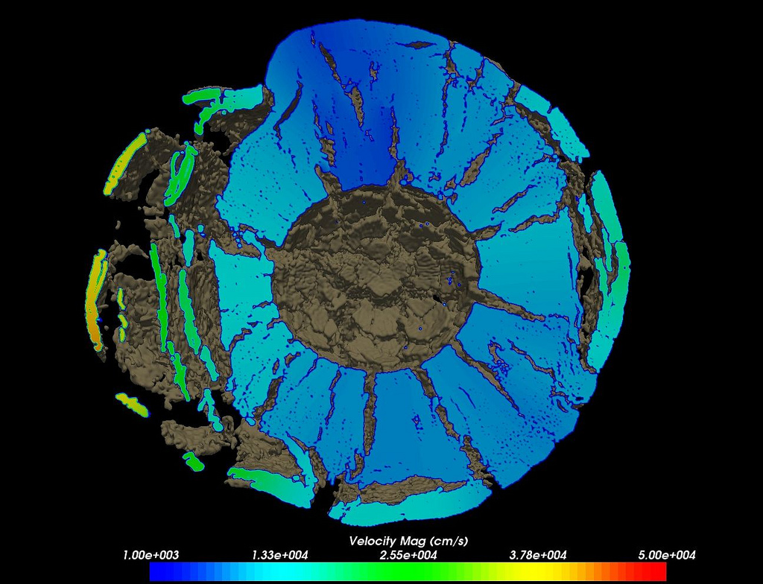
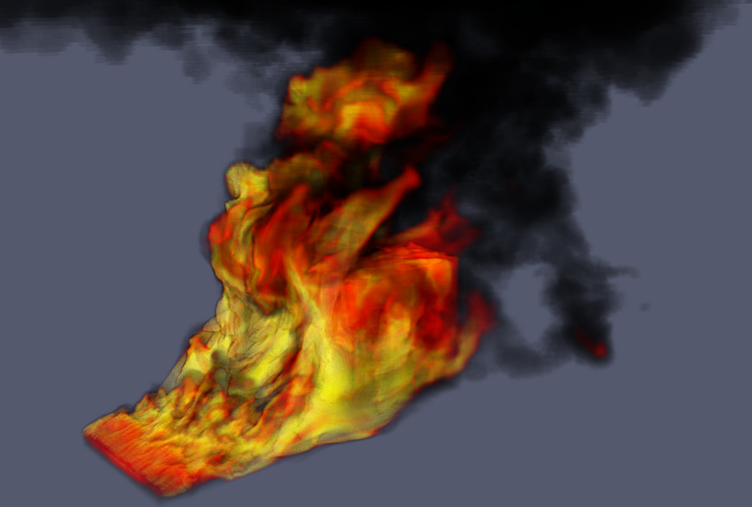
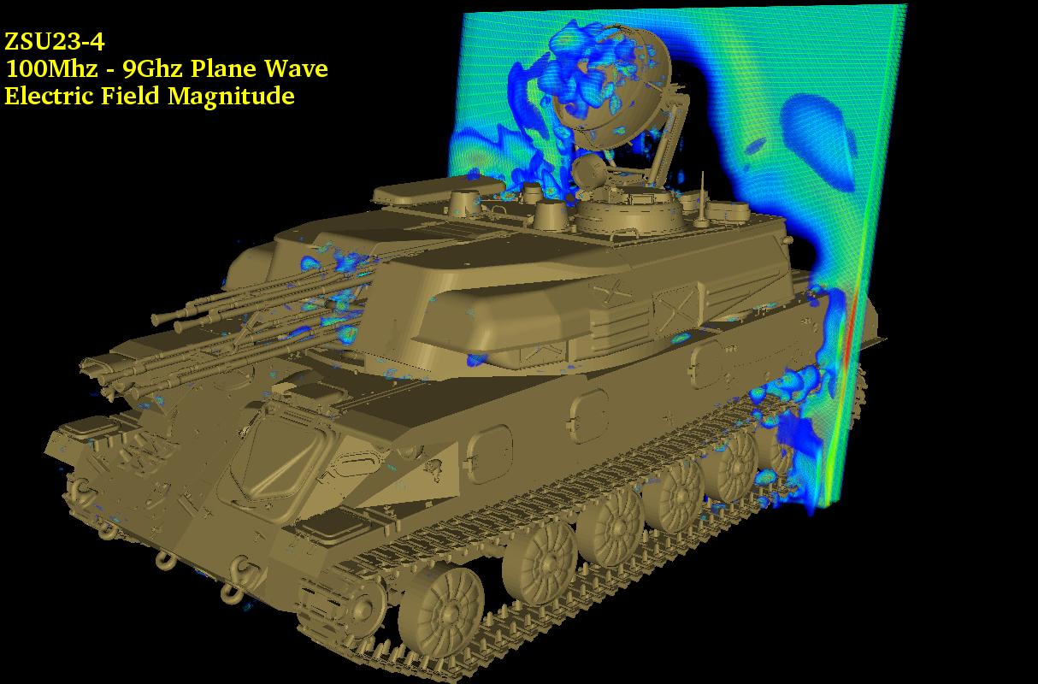
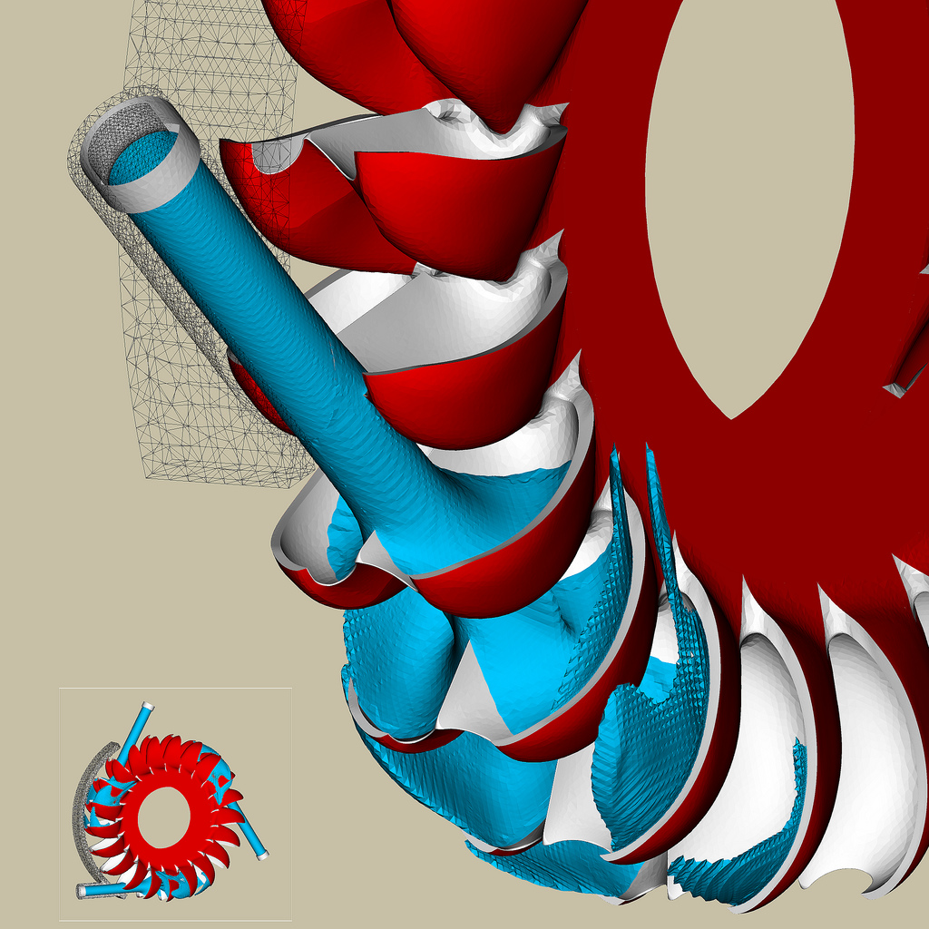
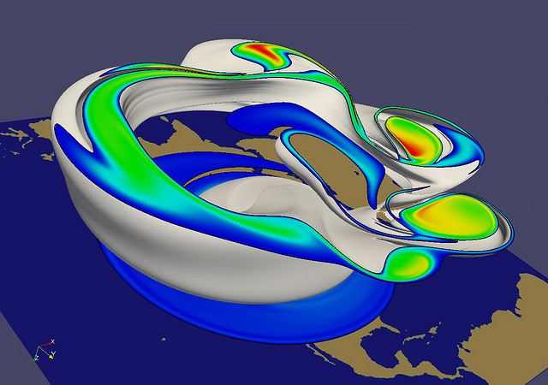
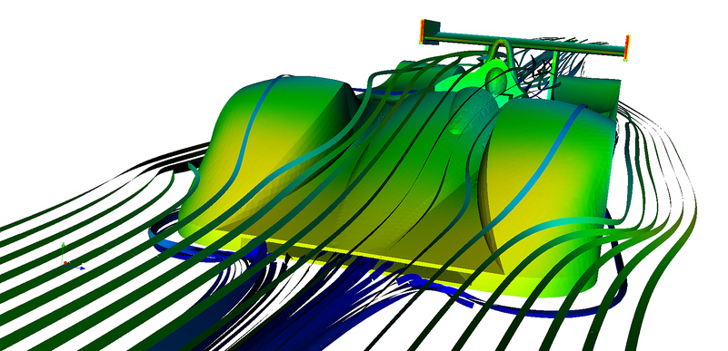
Example Uses of ParaView
Jerry Clarke, US Army Research Laboratory
Swiss National Supercomputing Centre
Renato N. Elias, NACAD/COPPE/UFRJ, Rio de Janerio, Brazil
Notes:
Small montage of projects using ParaView.
Demonstrates the breadth of utility ParaView has.

Slide 5
What is Interactive?
At a minimum, interactive is accessible.
Notes:
This talk, and whole minisymposium, is about interactivity.
The word “interactive” is vague and often used to mean different things in visualization literature.
Let’s spend a few minutes defining what it means to be interactive.
At its highest level, interactive means supporting bidirectional flow between computer and human user.
Usually commands from user and visual data displays from computer.
That’s a pretty broad spectrum of supporting technologies.
But the first criterion is that the user has physical access to the running program.
With large data, that in itself can be a challenge.

Slide 6
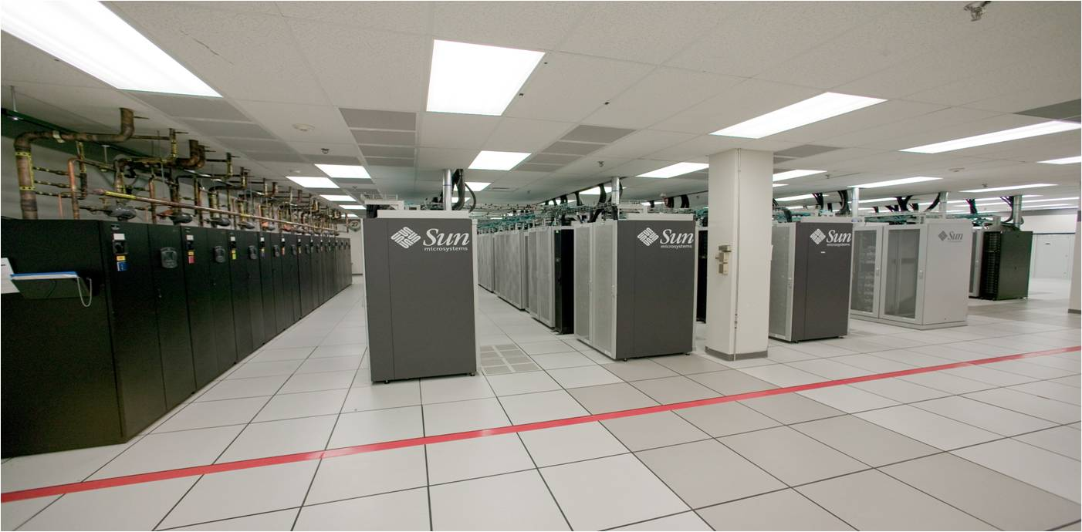
Interactive is Accessible
Notes:
If you are processing large enough data, you’ll need a high performance computing platform.
Your users are not going to have an HPC cluster in their office.
They generally look like this in a special computing facility (this is Red Sky/Red Mesa).
Fun to visit: tons of processors, wires, and blinking lights.
But the appeal wears of quickly.
Noisy: The cooling units (on left) are really loud.
Uncomfortable temperature: cooling system designed to keep computers from melting, not for people.
Generally cold in the room, except next to processors where it’s too hot.
After about 15 minutes ready to leave.

Slide 7
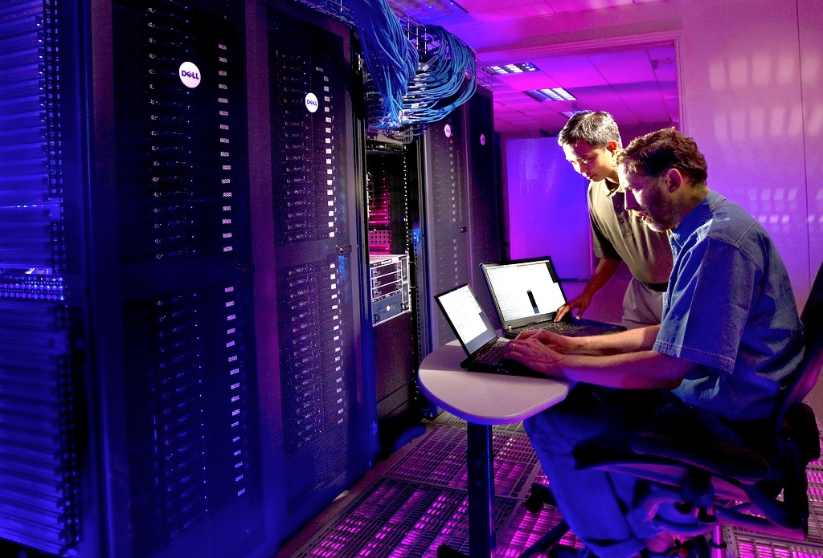
Interactive is Accessible
Notes:
When our group first started developing algorithms for large scale data interaction (before ParaView was available), we sometimes had to run on a terminal sitting in the computer room pugged directly into the HPC cluster.
I can attest, it sucks.
If your programs interactivity requires sitting right at the terminal, no one is likely to use it.

Slide 8
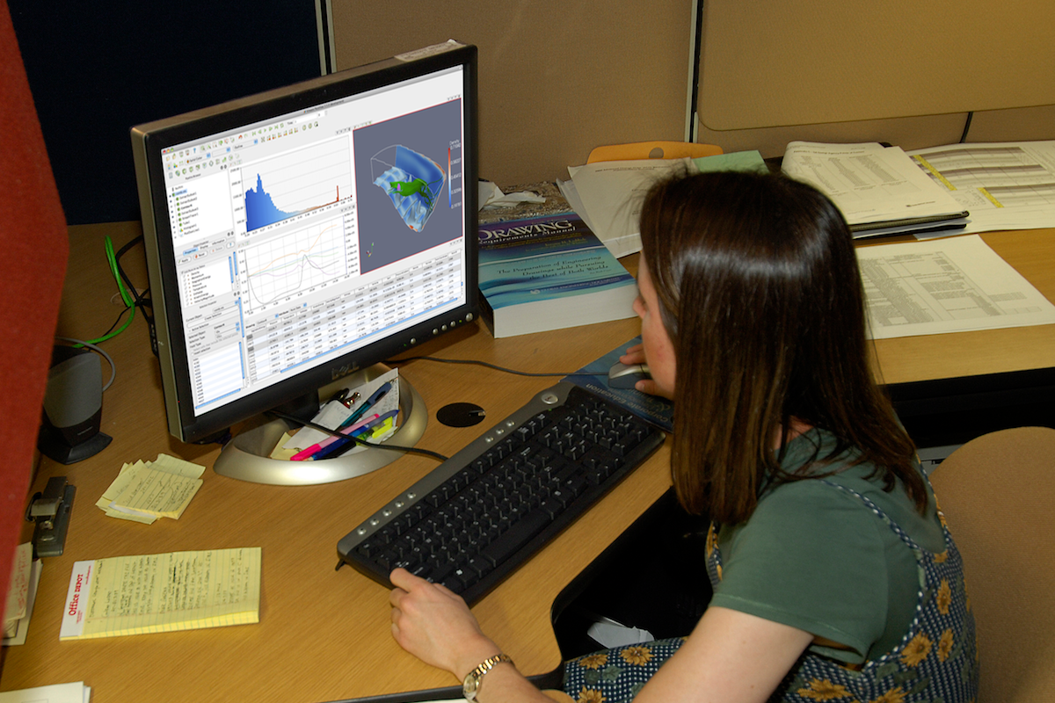
Interactive is Accessible
Notes:
What you need is the ability for users to interactively control the HPC job at their desktop (or laptop).
In our experience, tools do not get wide adoption unless users can easily run them in their office where the rest of their tools are.
This can only work if some computational service is running on the HPC and a client on the desktop connects.

Slide 9

Client-Server Architecture Makes Large Data Computation Accessible
LAN/WAN
ParaView GUI
(client)
pvserver
Notes:
To handle this, ParaView has a hard distinction between “client” components and “server” components.
Even when running ParaView locally on your desktop, you have a hidden connection to an internal server.
For large scale data, explicitly connect to a parallel server running remotely on an HPC system.
ParaView internally contains all the code necessary to establish and maintain connection.
Most challenging to develop: all internal commands must be marshaled through data stream.
Most flexible solution: only hardware/software needed is a socket connection.
Other solutions exist for quick implementation.
Remote desktop software allows a window created on the server side to be scraped to the client.
Can create special hardware connections to thin client terminals that remotely control the hardware.
These solutions require special software or hardware on the HPC systems.
For applications with a broad user base like ParaView, should develop the connection right in the software.

Slide 10
What is Interactive?
Interactive is “fast”
Notes:
Although accessibility is necessary, not sufficient
Interactive applications by definition serve data to human users.
Humans are impatient.
Usually when we say interactive we mean “fast.”
In a visualization program like ParaView, you can consider three broad classes of operations:
Loading data, processing data, and rendering data.
Each has separate considerations.

Slide 11
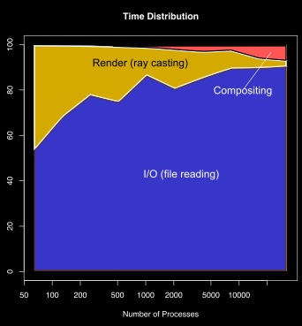
Fast Data Loading
Source: “Parallel Volume Rendering on the IBM Blue Gene/P,” Tom Peterka et al.
Notes:
File loading is easy to underestimate.
For large scale visualization, loading data from disk is by far the most expensive operation.
Gets more expensive the larger the processing job you have.
In this study from Argonne National Lab, we see I/O starts as the dominant operation and for larger jobs almost all the time is spent in I/O.
It’s important to read data as efficiently as possible.
Working against you is the fact that most files are optimized for writing, not reading.
Unless you want to make a career out of efficient file I/O, my advice is to choose a file format that comes with an efficient parallel library.
Examples include HDF5, netCDF, and ADIOS.

Slide 12
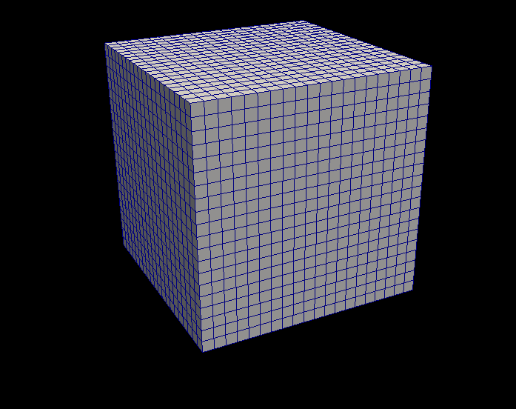
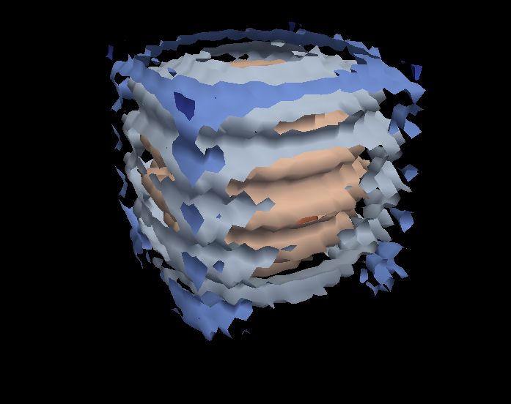
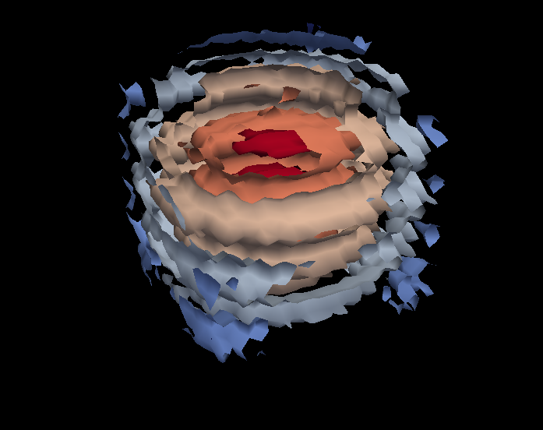
Fast Data Processing
Contour
Clip
Notes:
Next, we need to make sure that we can process data quickly.
This means running parallel algorithms to take advantage of the HPC system.
ParaView provides a collection of algorithms that can be connected together in a “pipes and filters” model.
Want to parallelize them all, but don’t want to spend a lot of time designing and managing parallel code for every filter.

Slide 13
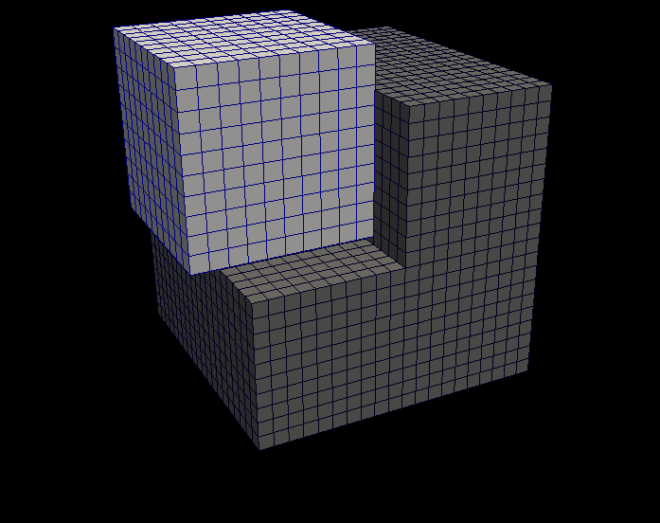
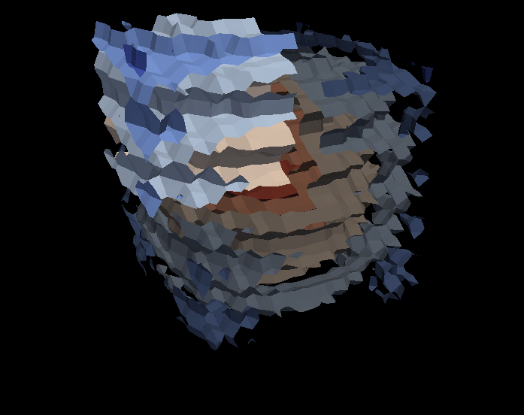
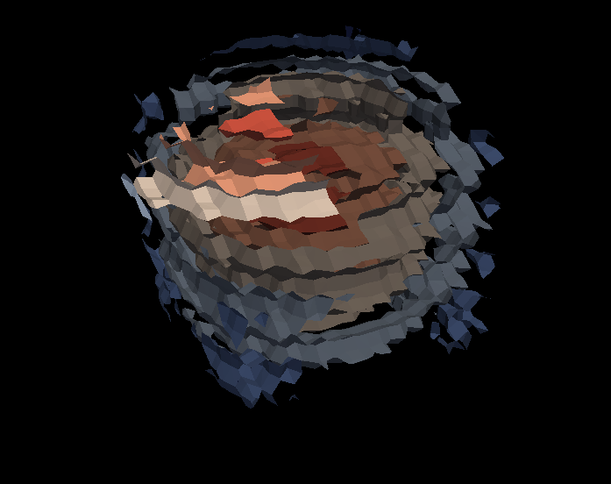
Fast Data Processing
Contour
Contour
Contour
Clip
Clip
Clip
Notes:
ParaView uses a data parallel model.
Data is partitioned and divided among the processes.
Each process runs an identical algorithm on a different piece of data.
The end result is that each process contains a partition of the result.
That brings us the the final task of rendering.
Our rendering challenge is two-fold:
We have lots of rendering work that needs to be coordinated among distributed processors.
Our data is distributed, not reasonably accessible globally.

Slide 14
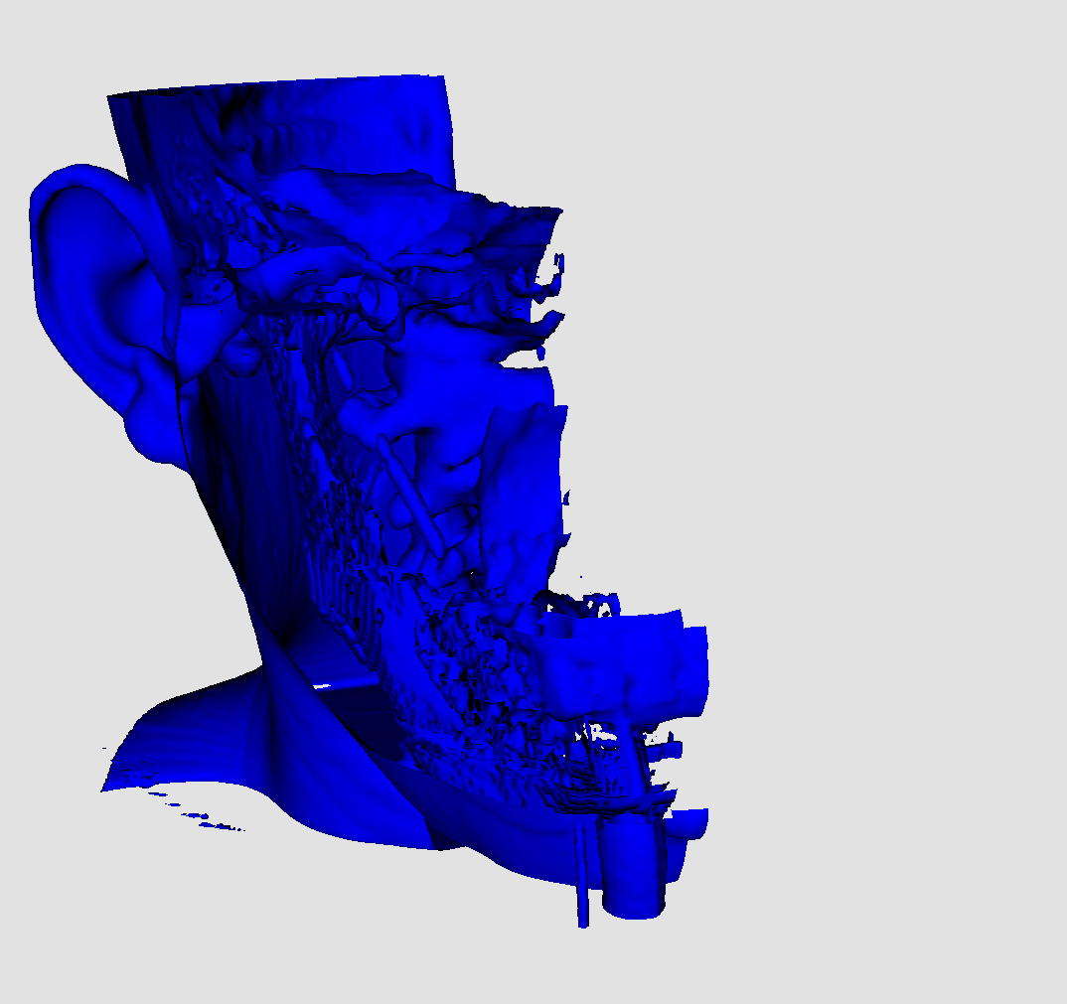
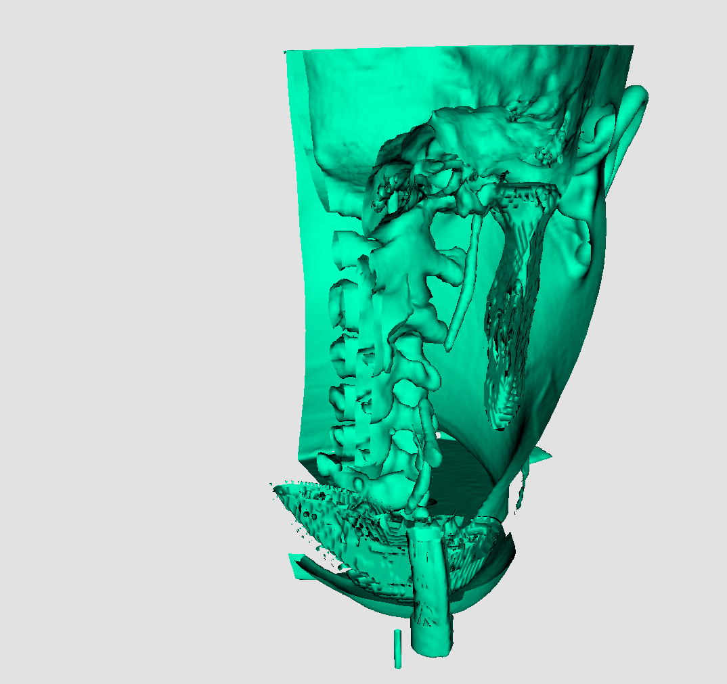
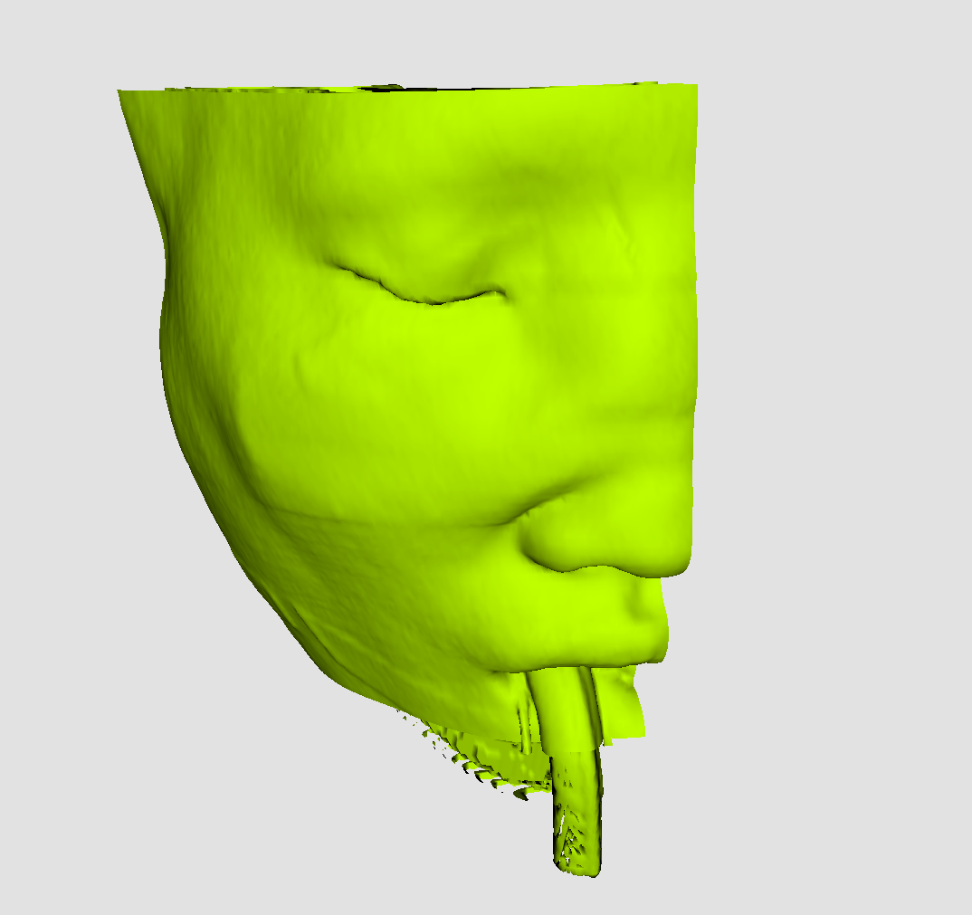
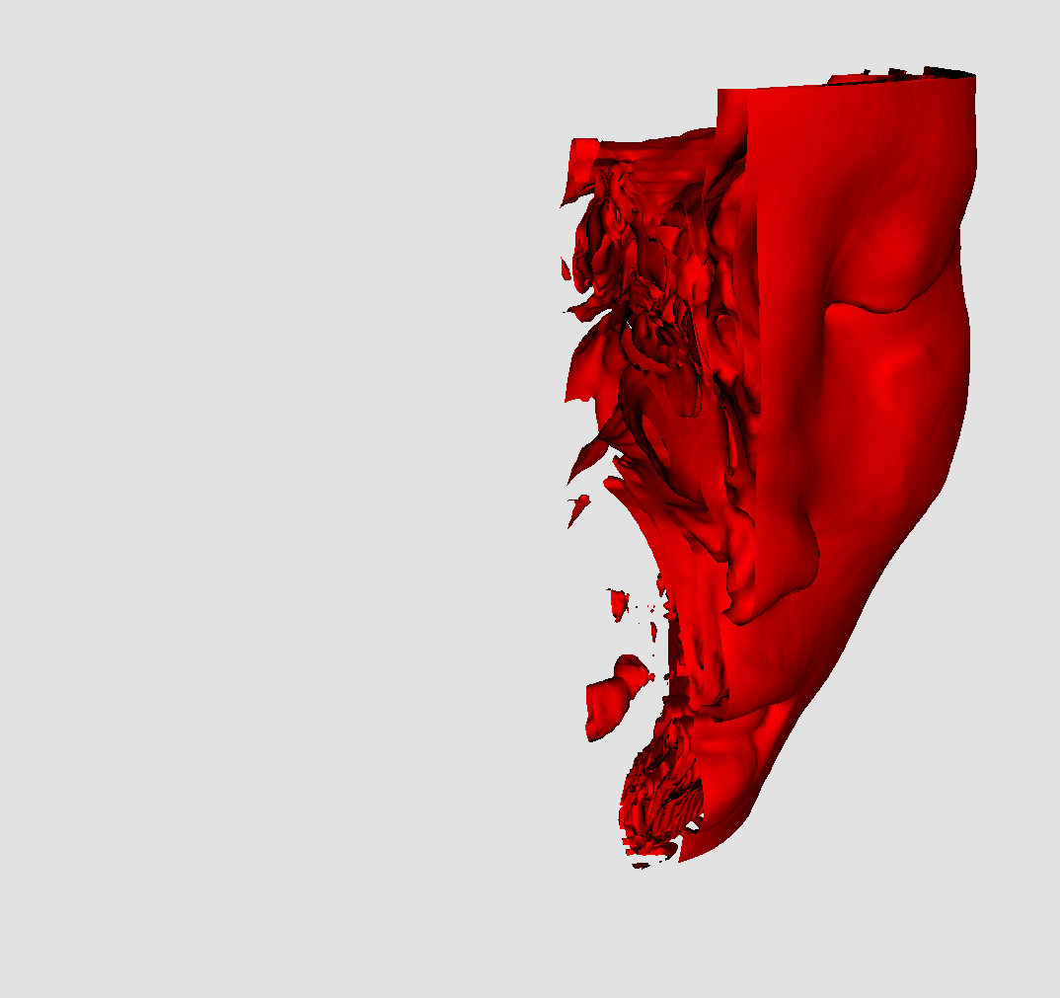
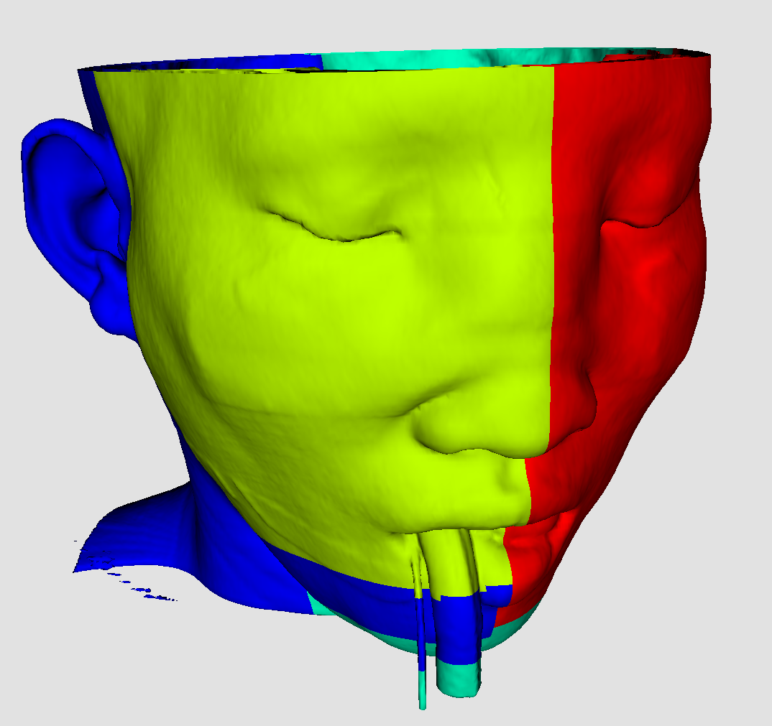
Fast Parallel Rendering
Notes:
ParaView solves both problems with its parallel rendering algorithm.
It uses what is known as a “sort-last” parallel rendering algorithm.
The basic idea is that each process renders whatever data is local. Partitioned geometry stays where it is.
The rendered images are then combined together in a “compositing” step to form a single image.
This image, however, is a bit over-simplistic.

Slide 15
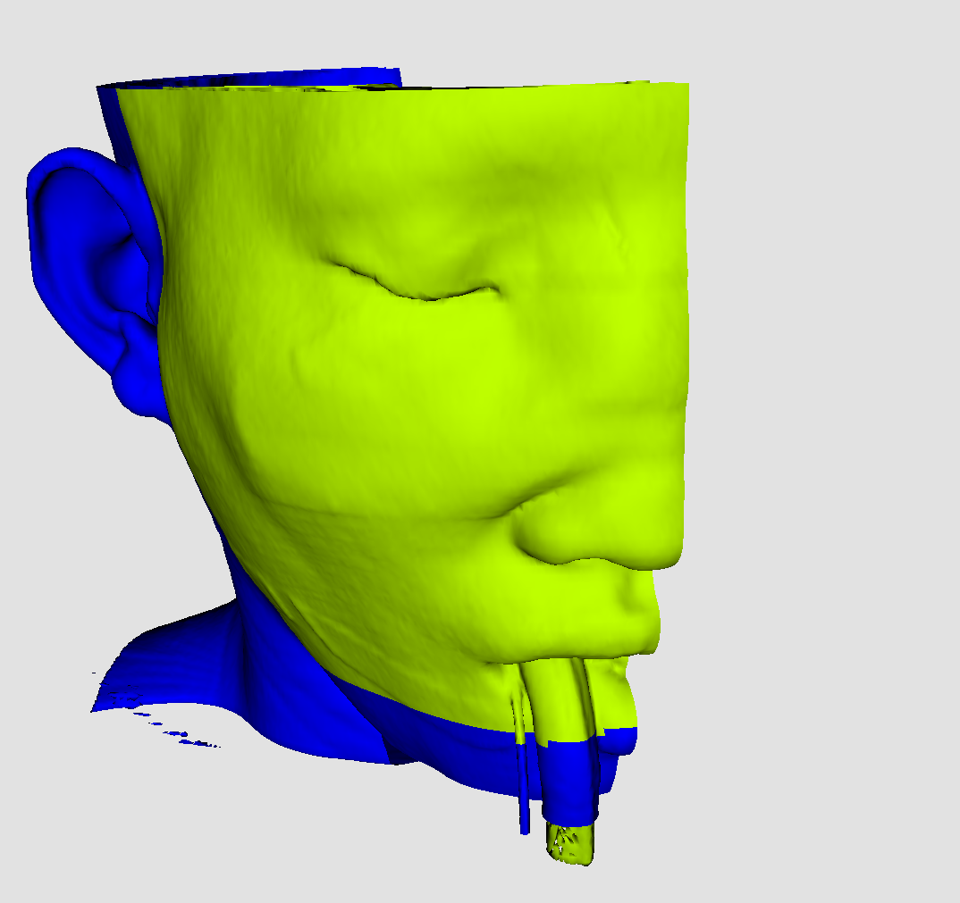
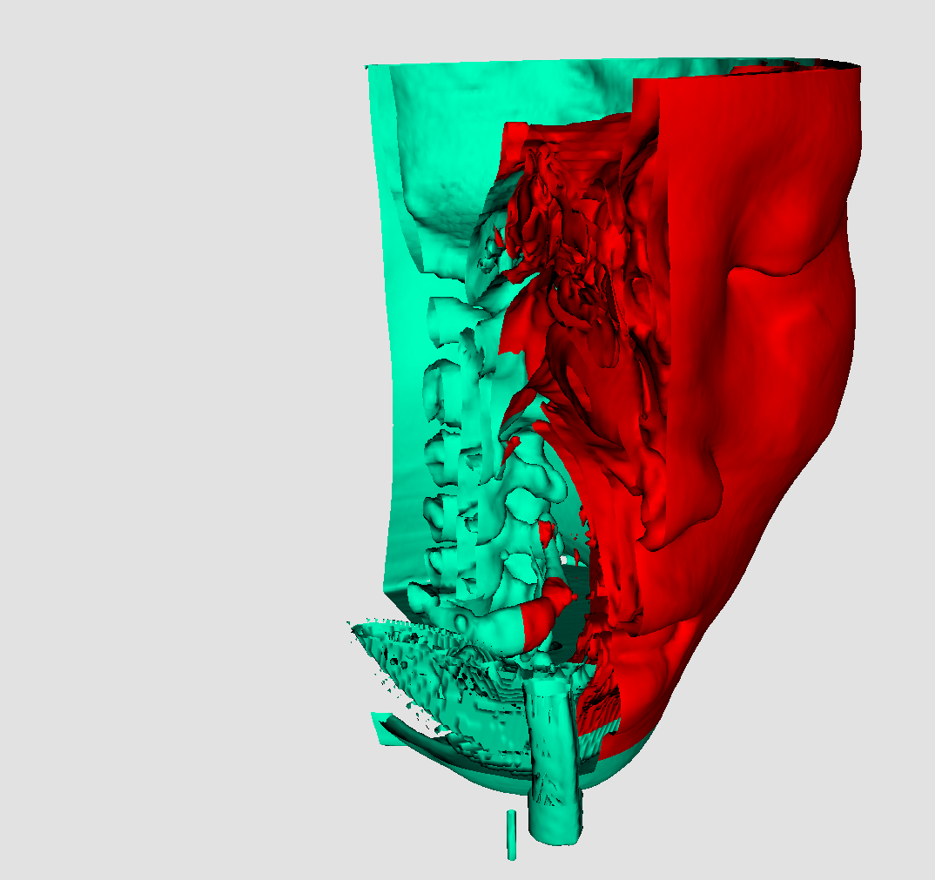
Parallel Rendering
Notes:
ParaView solves both problems with its parallel rendering algorithm.
It uses what is known as a “sort-last” parallel rendering algorithm.
The basic idea is that each process renders whatever data is local. Partitioned geometry stays where it is.
The rendered images are then combined together in a “compositing” step to form a single image.
The actual parallel compositing algorithm uses divide and conquer to load balance the work and recursively combine all the pixels.

Slide 16
What is Interactive?
Interactivity demands responsiveness
Notes:
Why do we want interactivity to be fast?
Operations must happen within a certain amount of time due to limited user availability and attention span.
Specifically, too long of a delay can ruin the thought process.
Thus, interactivity demands responsiveness.
An interactive algorithm must complete quickly to satisfy user needs.
When a paper says “interactive,” it usually means fast enough for a person.
How fast is interactive?
Literature surprisingly inconsistent. Interactive can mean pretty much whatever you want it to.
In truth, the required speed is dependent on the operation.

Slide 17
Interactive is Responsive
Brush Time
Real Time
Click Time
Wait Time
Coffee Time
Batch Time
0.1 sec
1 sec
10 sec
100 sec
Notes:
Real time (VR/Immersion) <= 1/20 sec
3 – 12 Hz people throw up (barf-o-genic zone)
Brush time (mouse dragging) <= 1/10 sec
After 100 ms users notice a lag
Click time (GUI response) <= 1 sec
Thought time?
Wait time (computation finish) <= 30 sec
Coffee time (take a break) <= 2 min
Batch time (check tomorrow morning) whatever

Slide 18
Interactive is Responsive
Brush Time
Real Time
Click Time
Wait Time
Coffee Time
Batch Time
Computation
0.1 sec
1 sec
10 sec
100 sec
Response Time
Notes:
With this breakdown of response time, we can compare them to the computation that can be done.
Given some required response time, there is some real limitation on the amount of computation that can be done in that amount of time.
We can consider a plot of response time vs. the amount of computation that can be done.

Slide 19
Interactive is Responsive
Computation
Area of Plausibility
Brush Time
Real Time
Click Time
Wait Time
Coffee Time
Batch Time
0.1 sec
1 sec
10 sec
100 sec
Response Time
Notes:
There is some curve on the plot that is the best we can do. We can’t compute any faster.
Below this curve is the area of plausibility. We can compute the computation in the necessary amount of time.
Above this region, our system fails to be interactive.

Slide 20

Interactive is Responsive
Computation
Area of Plausibility
Brush Time
Real Time
Click Time
Wait Time
Coffee Time
Batch Time
0.1 sec
1 sec
10 sec
100 sec
Response Time
Notes:
Every operation we do can be plotted based on the amount of computation required and the maximum response time we can tolerate.
If this point is in our area of plausibility, we’re fine.

Slide 21
Interactive is Responsive
Computation
Area of Plausibility
Brush Time
Real Time
Click Time
Wait Time
Coffee Time
Batch Time
0.1 sec
1 sec
10 sec
100 sec
Response Time
Notes:
But what if we have an operation outside of our area of plausibility?
Say, for instance, you have a large data set that takes about a second to render: too longer for brushing interactivity.
How do you adjust your system to handle this computation in the amount of time you need.

Slide 22
Interactive is Responsive
Computation
Area of Plausibility
Brush Time
Real Time
Click Time
Wait Time
Coffee Time
Batch Time
0.1 sec
1 sec
10 sec
100 sec
Response Time
Notes:
You could try moving your area of plausibility to cover your use case.
You do that by investing in your hardware and software.
It’s expensive and not sustainable.
So your customer says they need to render 1 billion polygons and it’s too slow.
You say, buy this 1 million euro computer and problem solved.
Two years later, your customer has 10 billion polygons to render, and it’s too slow.
You say, buy this next generation computer for another 1 million euros.
Think you’ll get it?
In your initial HPC investment for large-scale data, you can try to cover your use cases, but eventually you’ll run past hardware limitations before it’s time to invest again.

Slide 23
Interactive is Responsive
Computation
Area of Plausibility
Brush Time
Real Time
Click Time
Wait Time
Coffee Time
Batch Time
0.1 sec
1 sec
10 sec
100 sec
Response Time
Notes:
What else can you do?
You can move the computation into the area of plausibility by doing less work.
You are basically the full problem with a smaller problem.
“We are taking your 1 billion cell simulation and showing you 50 thousand cells.”
Will that fly? No.

Slide 24
Interactive is Responsive
Computation
Area of Plausibility
Brush Time
Real Time
Click Time
Wait Time
Coffee Time
Batch Time
0.1 sec
1 sec
10 sec
100 sec
Response Time
Notes:
What else can you do?
You could allow the computation to take longer. Basically doing nothing.
“You’re only rendering at 1 Hz? Too bad!”
Have you ever tried to place a camera or a clip plane when the system updated only once per second.
It’s really hard and very frustrating.
Eventually, users will give up.
They’ll use some crummy scripted visualization package written in the 1970 because it doesn’t require interaction.
I’m not kidding on that point. We just recently converted some diehards at Sandia from such a program, and that was only after implementing its scripting language in ParaView.

Slide 25
Interactive is Responsive
Computation
Area of Plausibility
Brush Time
Real Time
Click Time
Wait Time
Coffee Time
Batch Time
0.1 sec
1 sec
10 sec
100 sec
Response Time
Notes:
So how do you solve the problem? Realize that you don’t have to do everything all the time.
There are times when you need to finish fast, but don’t need all the details.
There are times when you need all the details, but don’t need the results fast.
So implement both and switch between the two.

Slide 26
Interactive is Responsive
Still
Render
Computation
Interactive
Render
Area of Plausibility
Brush Time
Real Time
Click Time
Wait Time
Coffee Time
Batch Time
0.1 sec
1 sec
10 sec
100 sec
Response Time
Notes:
In ParaView, for rendering we have two different rendering modes.
We have an interactive render. This is the render used when interacting directly with the 3D view: e.g. rotating the model or manipulating a cut plane.
For this, you don’t really need details. You just need a general location.
We then have a still render. This renders the full detail in however long it takes.
For this, the user stopped manipulating the 3D view. We’ve now moved to click or wait time, so we now can do the computation we need.

Slide 27
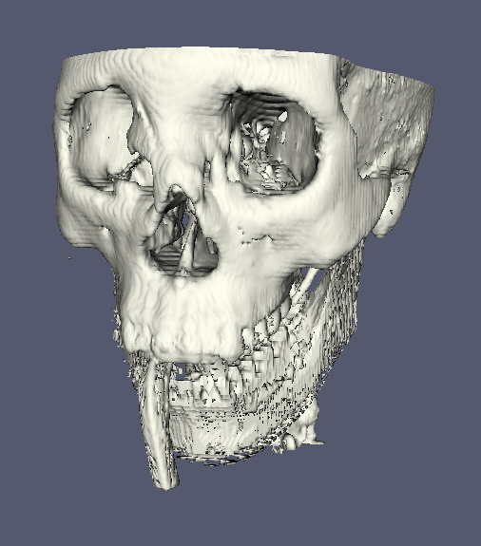
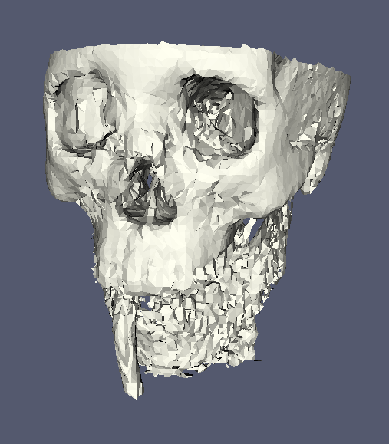

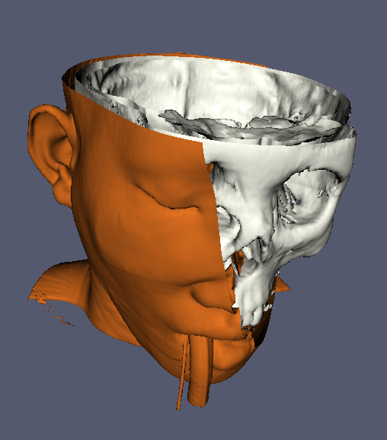
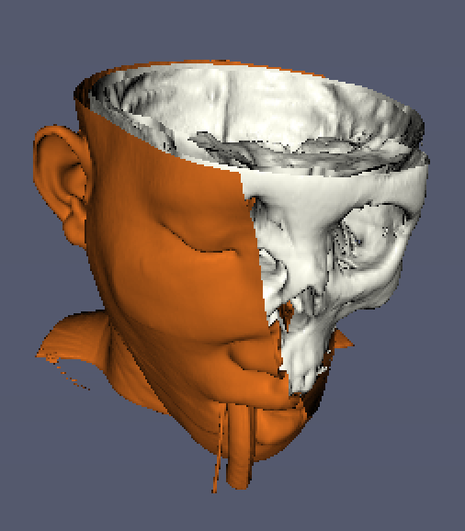


Rendering Levels of Detail
Geometric
Original Data
Divisions: 50x50x50
Divisions: 10x10x10
Image
Original Data
Subsample Rate: 2 pixels
Subsample Rate: 4 pixels
Subsample Rate: 8 pixels
Notes:
Here are two examples of rendering LOD in ParaView.
Top: geometric level of detail.
Left image original data used in still render.
If too big to render fast enough, can use smaller decimated image in its place.
Default middle. Ridiculous maximum setting at right.
Bottom: image level of detail.
Parallel rendering and image transfer overhead based on image size.
If too many pixels to composite, transfer in time, render smaller images.
Left, full resolution used in still. Progressively smaller renderings to the right.
Not shown: loss in image compression for transfer.

Slide 28
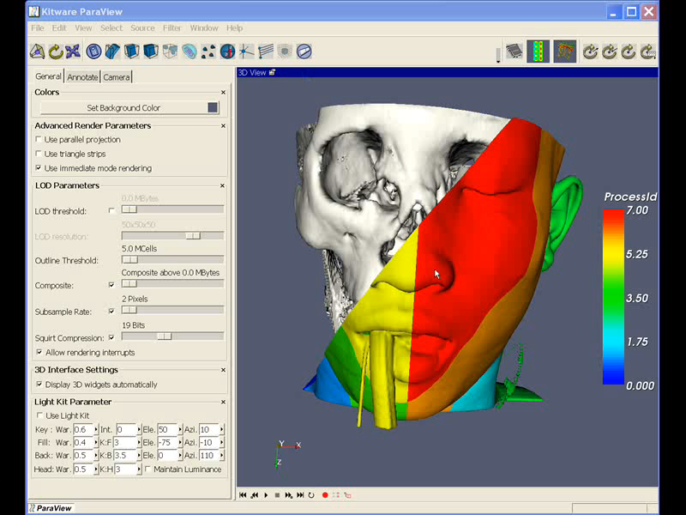
Notes:
To play on mac, install Perian codecs (perian.org).

Slide 29
Interactive is Responsive
Refined
Mesh
Coarse
Mesh
Computation
Area of Plausibility
Brush Time
Real Time
Click Time
Wait Time
Coffee Time
Batch Time
0.1 sec
1 sec
10 sec
100 sec
Response Time
Notes:
So that’s rendering, but what about some other visualization processing.
Have more leeway because we can wait many seconds for reading/filtering data.
Still, as data grows large, it may become feasible for most users.
You can pull the same trick as before.
This time, start with coarse mesh to show overview quickly.
As time becomes available, “sweeten” the image by loading refinements of the mesh.

Slide 30
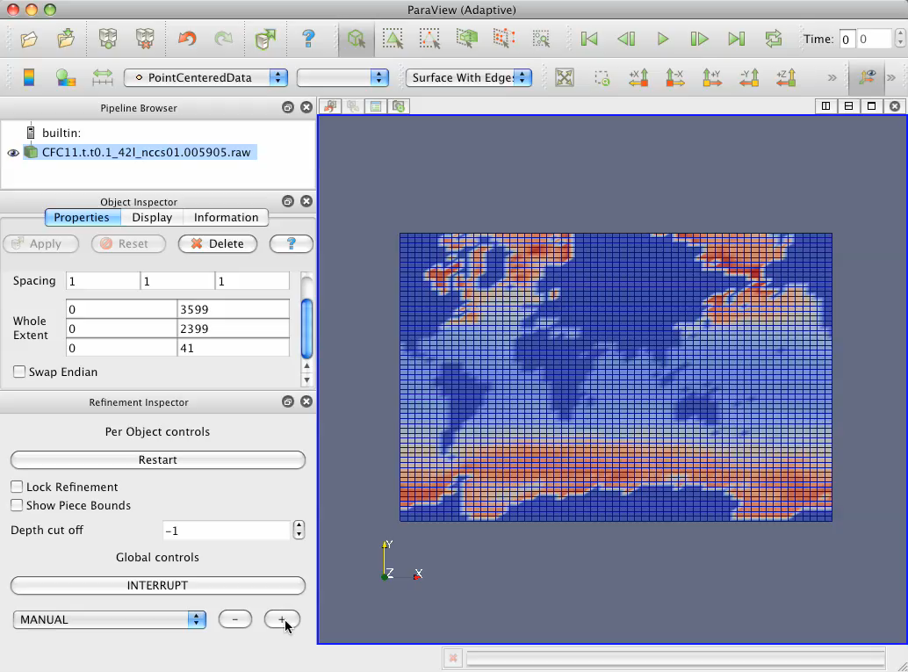
Notes:
Adaptive streaming is implemented in a special version of ParaView called StreamingParaView.
Shows coarse data first, then “sweetens it”.
Note that although rendering is mature, adaptive streaming is still in its infancy.

Slide 31
Summary
Interactive is Accessible
Large scale needs HPC.
Deliver that to your user’s desktop.
Make it work on small data too.
Interactive is Fast
You’re all over this, right?
Interactive is Responsive
Know your time constraints.
They change depending on what you are doing.
Have a contingency plan.
Use levels of detail to hit time constraints.

